Slide 1



Git Mini Project
Yashwanth Naidu

Slide 2
Overview
Create ec2 instance
Create repo in local machine
Creating repo in remote location – github
Working with remote repo
Pushing a locally crated repo to github)
Creating a new branch from your main branch
Pull all the branchs in your local machine
Merge our feature branch with main branch
Updating local repo

Slide 3

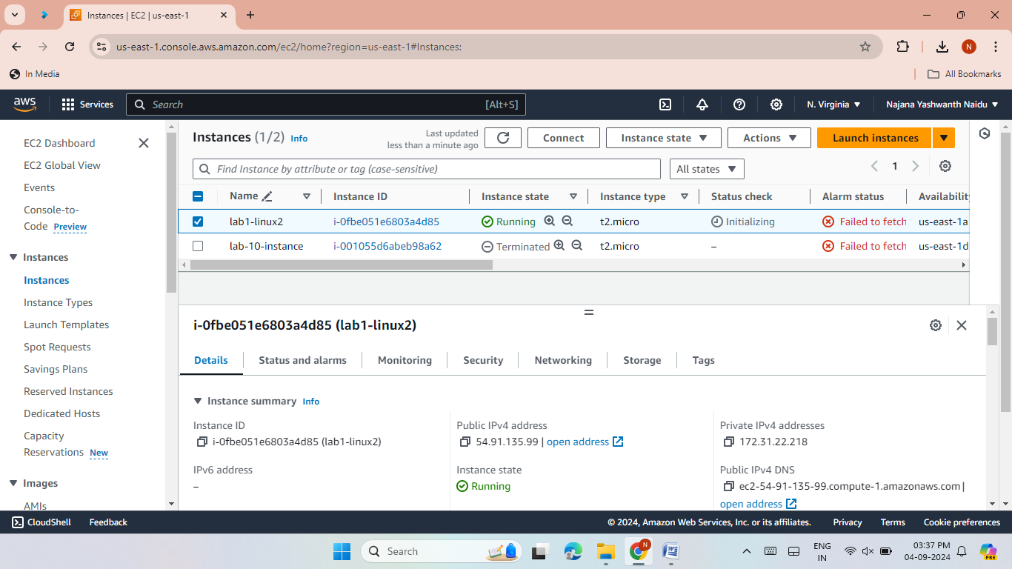
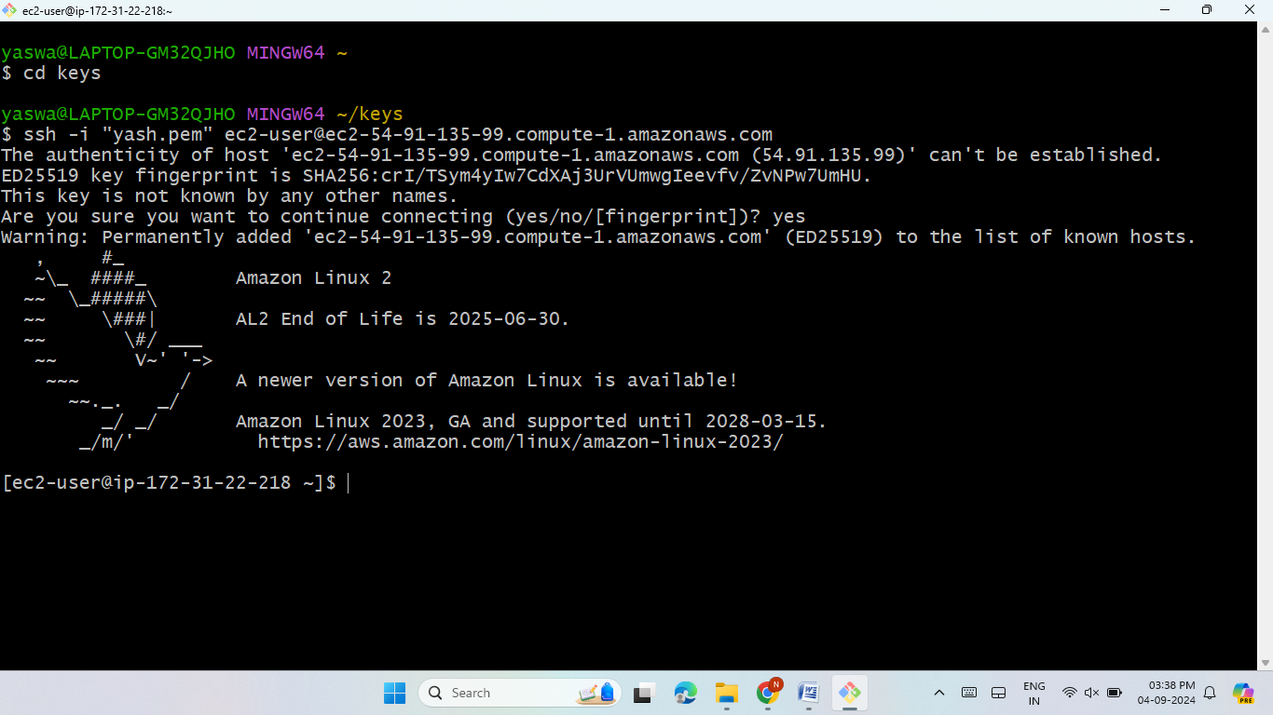
Lab 1-Create EC2 Instance
Launched an EC2 instance using Amazon Linux 2 AMI.
Connected to the server using Putty/Gitbash.

Slide 4
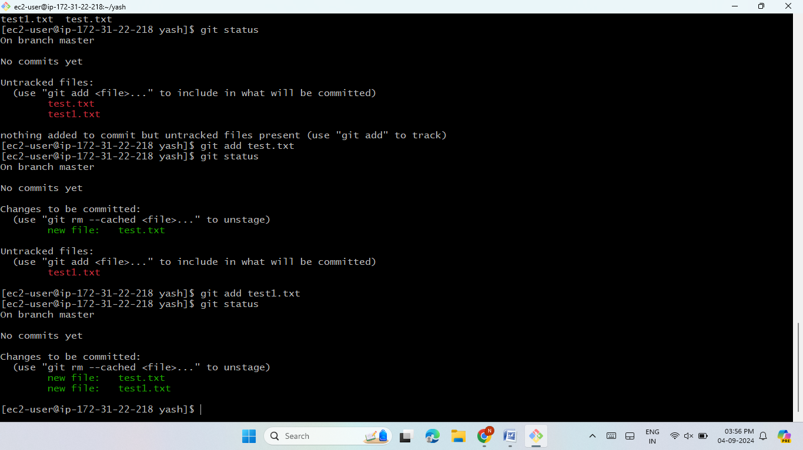

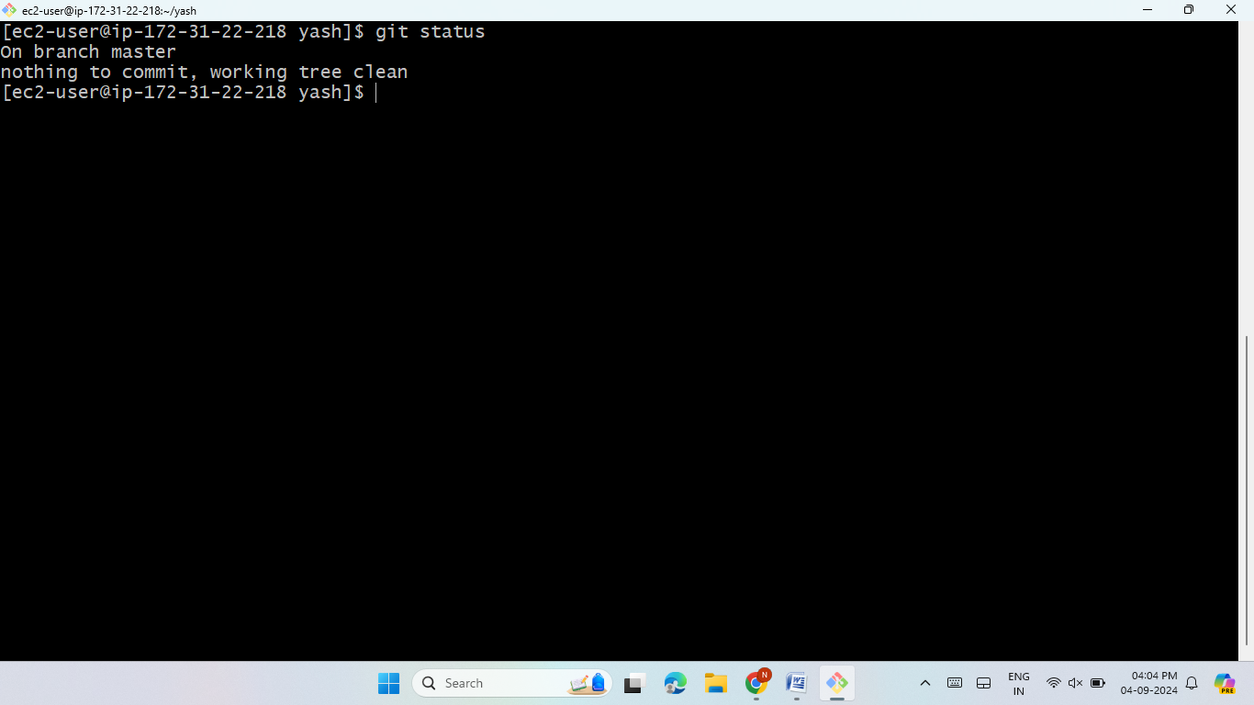
Lab 2 -Create Repo in Local Machine
Created a folder using mkdir.
Installed Git and initialized the repo using git init.
Check the status using git status command.
Create some files using touch command.
you can notice that the file is available but not tracked by Git.
Move files from working to Staging using git add.
Committed changes with git commit -m.
Check the status using git status command.
We can observe the changes.

Slide 5

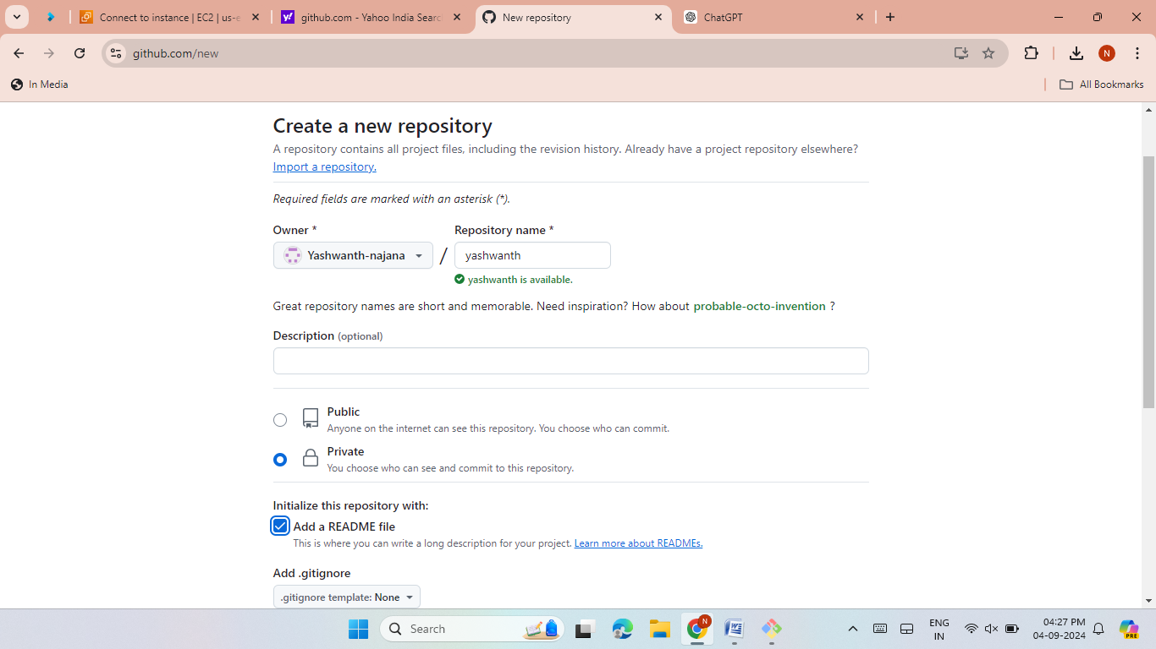
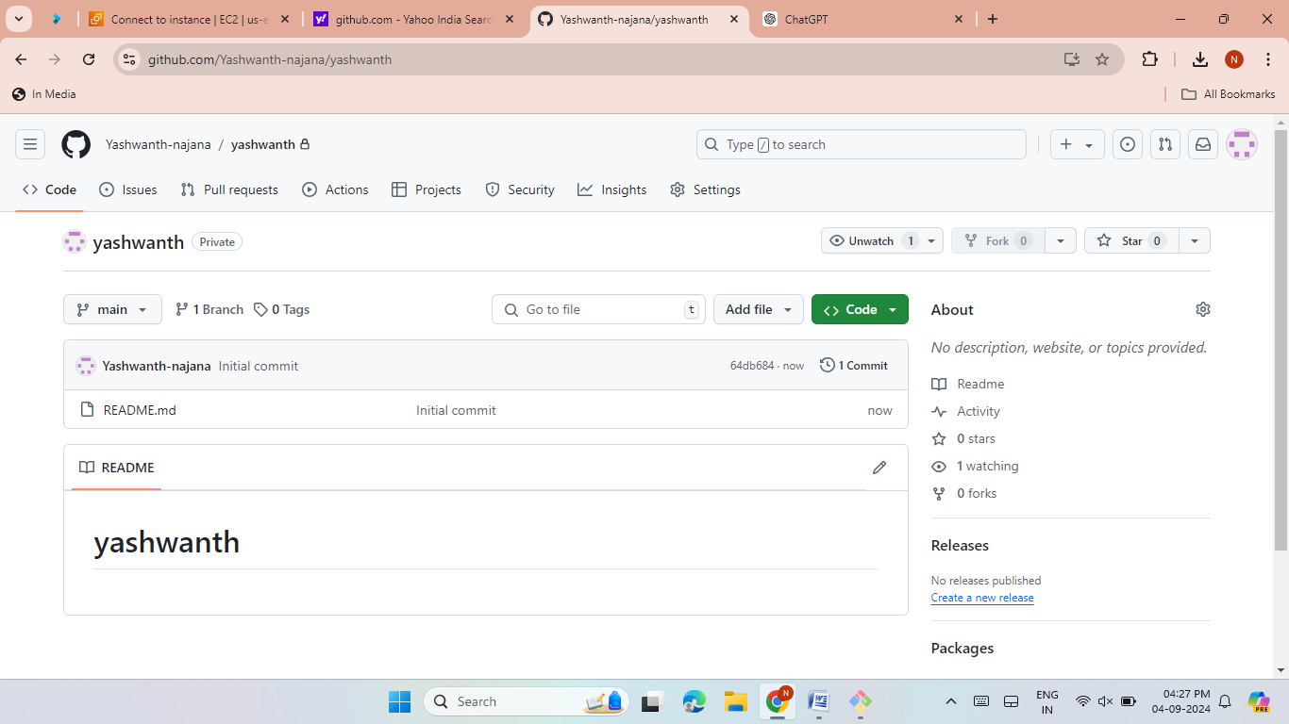
Lab 3 - Creating Repo in GitHub
Created a new GitHub repository.
Chose repository visibility (private).
Initialized the repo with a README file.
Click on create repo.

Slide 6



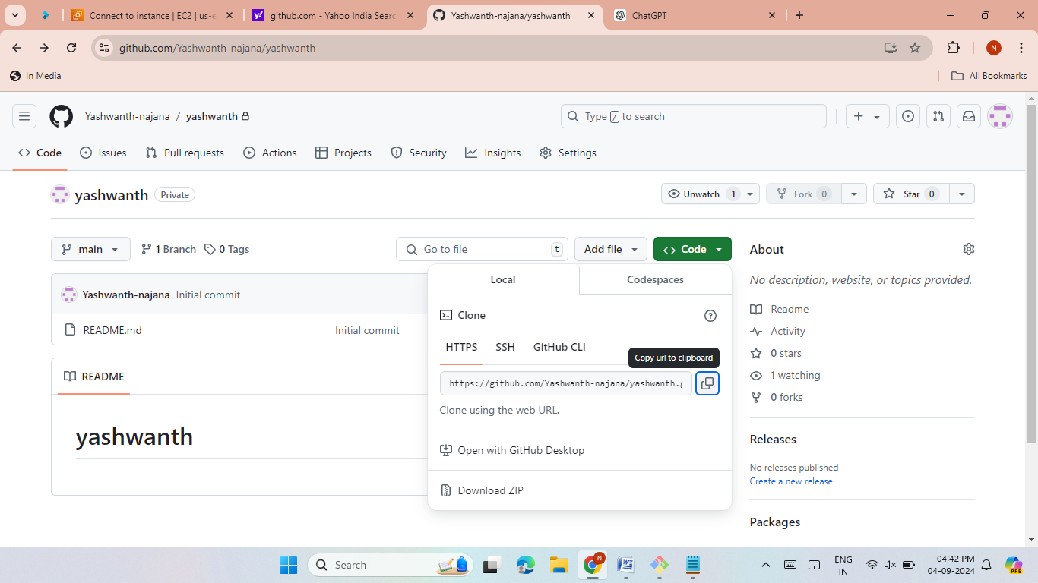
Lab 4 -Working with Remote Repo
Cloned the GitHub repository using git clone.
Created a personal access token to work with the remote repo.
Go to settings →go to developer settings → go to personal access token→ select tokens (classic) → select generate token.

Slide 7
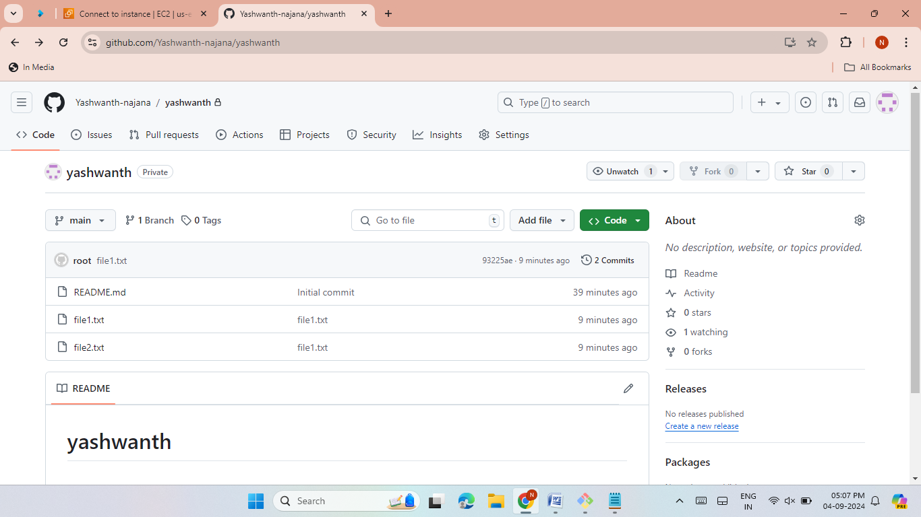
Create some files in that repo then add and commit the changes.
Pushed changes from the local machine to the remote repo.
We can observe the changes.

Slide 8



Lab 5 -Pushing a Local Repo to GitHub
Created one repo in our local machine and initialize is locally.
Create one remote repo with the same name as local repo in github .
Create files using touch then add and commit the files.
Check the status. It shows nothing to commit , working tree is clean.
Create a branch then push the repo.
git branch –m master ( to change the name of branch as master branch)
git remote add origin<URL of your remote repo>
Git push –u origin master.(to push your local branch to remote repo)

Slide 9
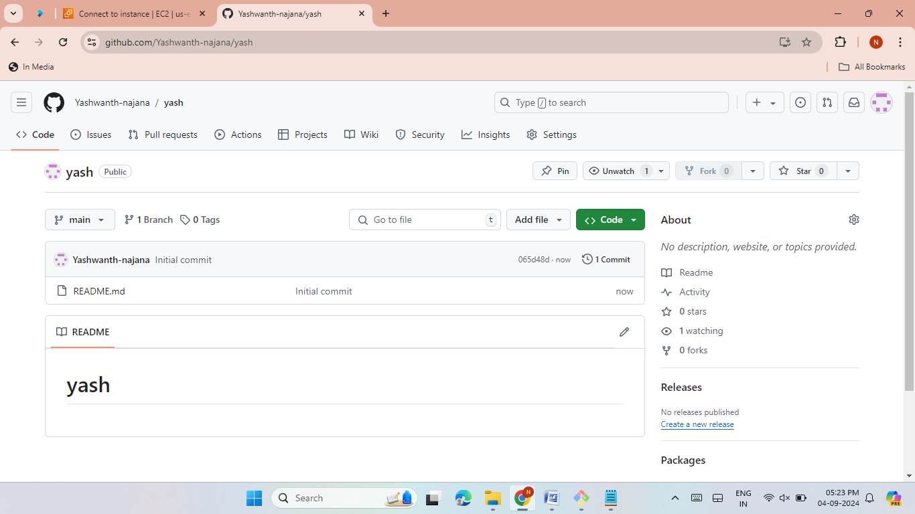
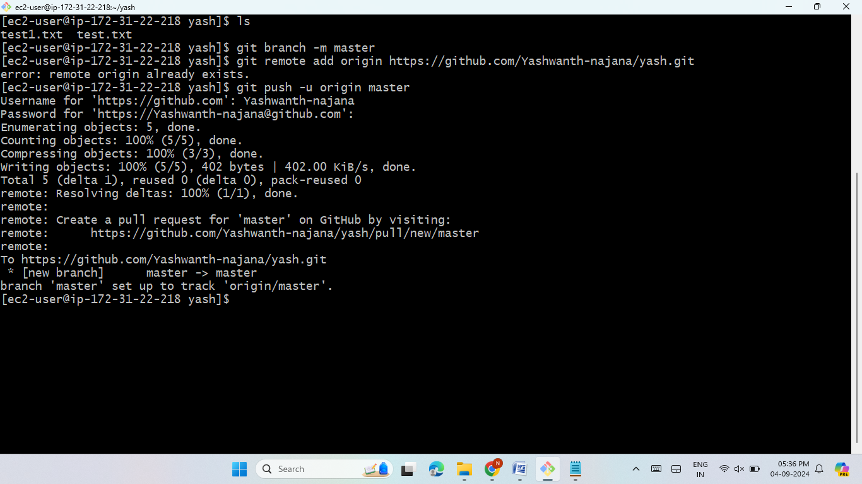
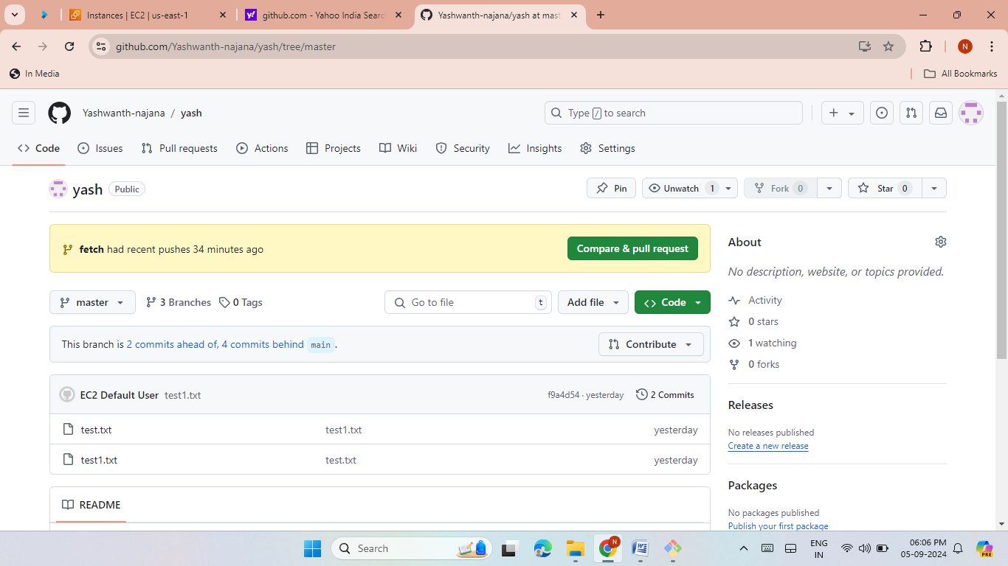
.

Slide 10

Lab 6 -Creating a New Branch
Created a new branch in GitHub.
Made changes specific to the new branch.
First clone the repository then check the files.
Run the following commands.
git branch
Git branch fetch (to get the branch fetch)
Git switch fetch (to change the branch main to fetch)
Create some files using the touch command then add and commit the files.
Then check the status, it shows nothing to commit, working tree is clean.
git push -u origin <branch>.
Verified changes were only in the new branch.

Slide 11
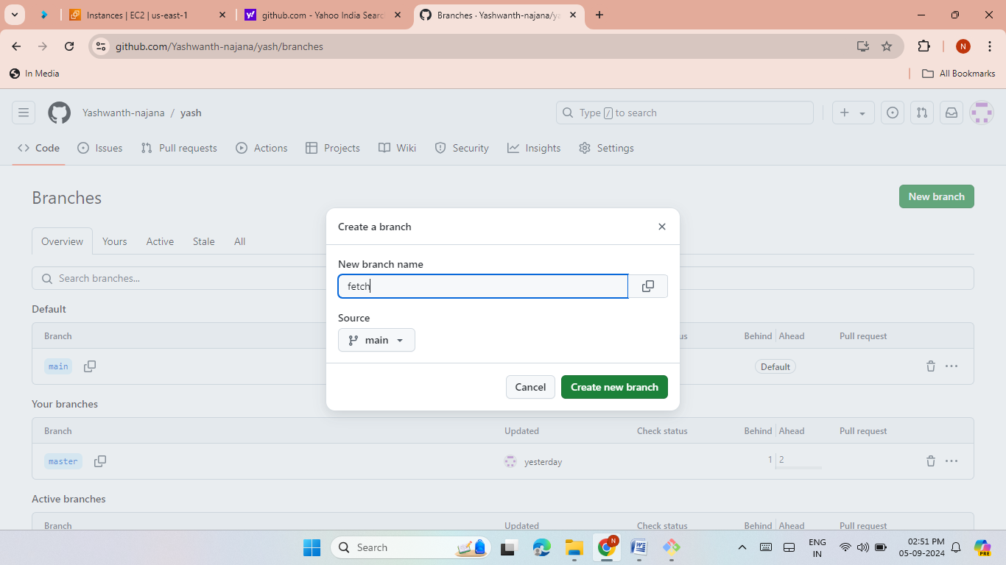
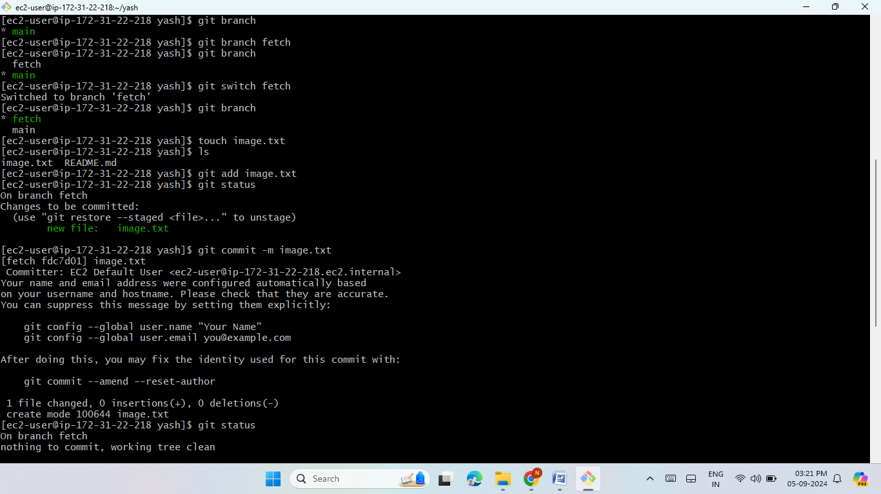
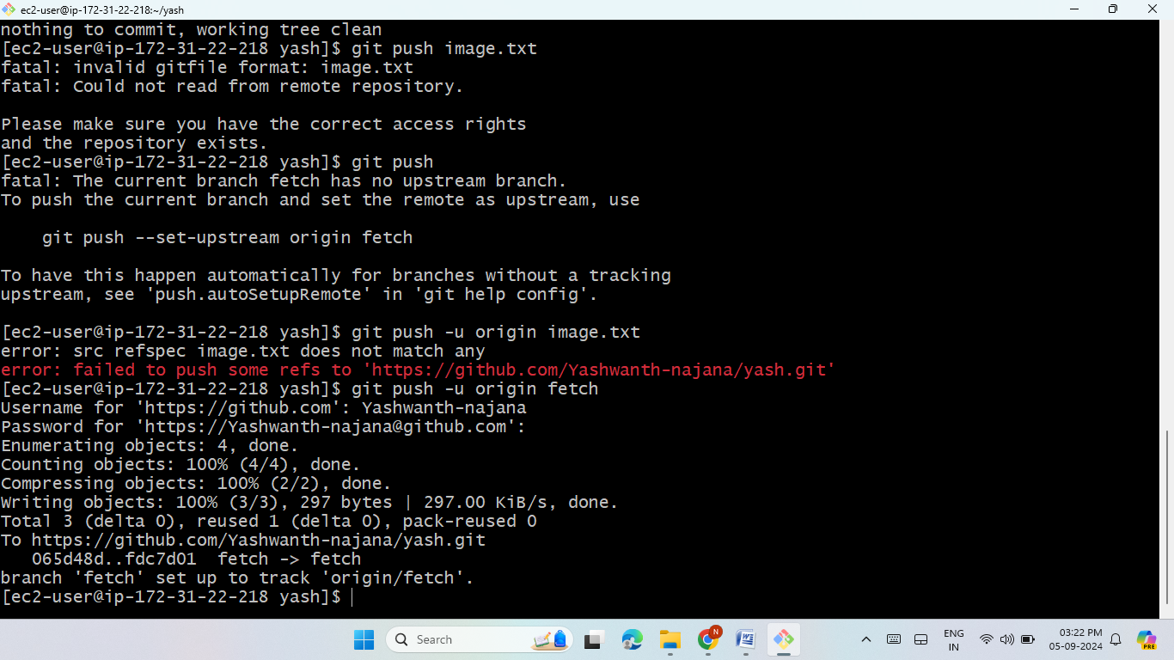
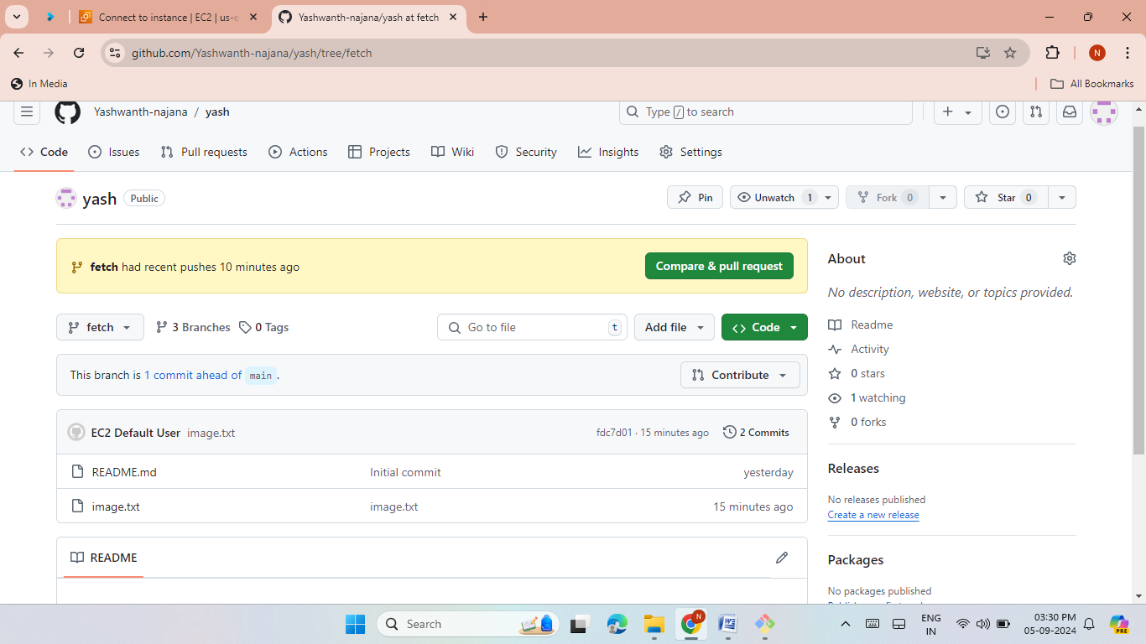


Slide 12

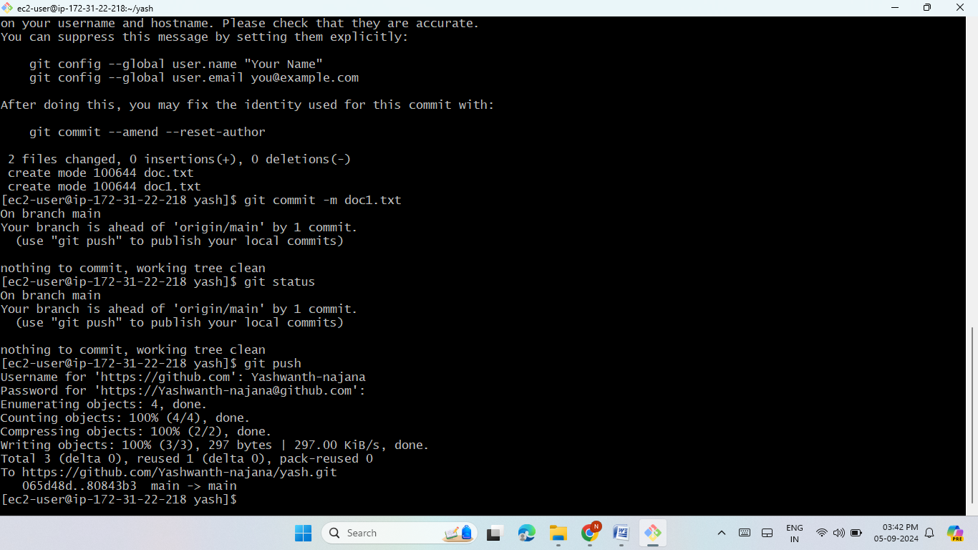
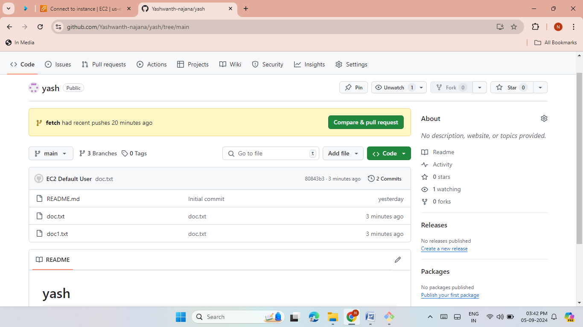

LAB 7 (PULL ALL THE BRANCHS IN YOUR LOCAL MACHINE)
Pulled all branches from the remote repo using git pull.
Listed all branches with git branch -a.
Go to new branch (git checkout<branch name> ) then create files ,add files, commit files.
Check the status.
Checked out a specific branch and made changes.

Slide 13
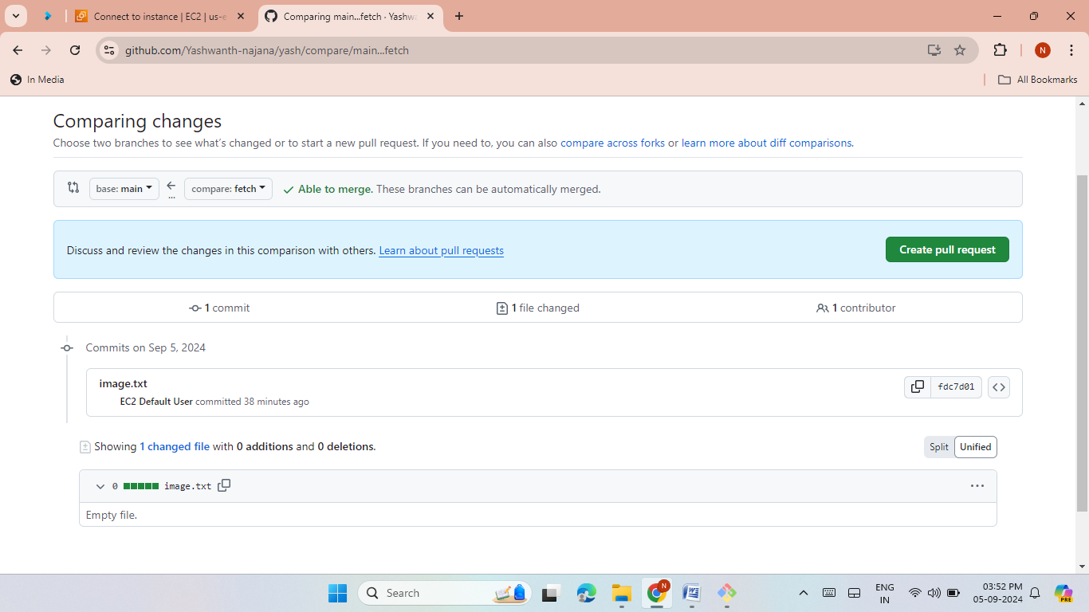
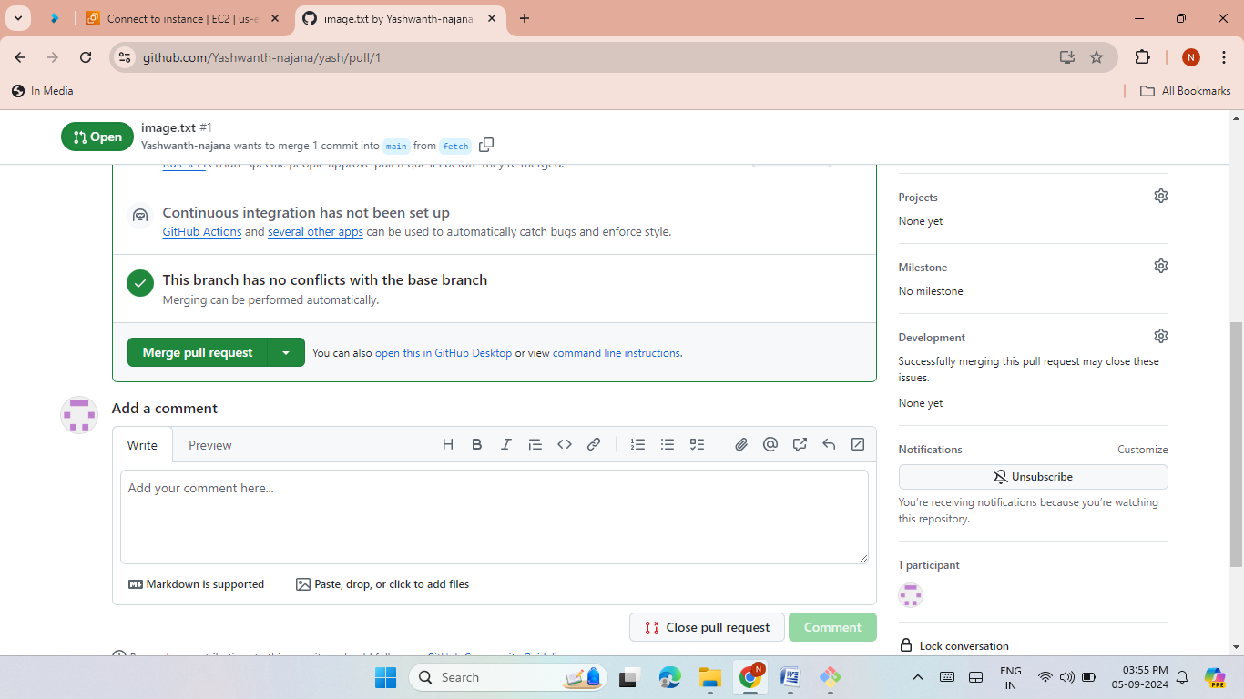
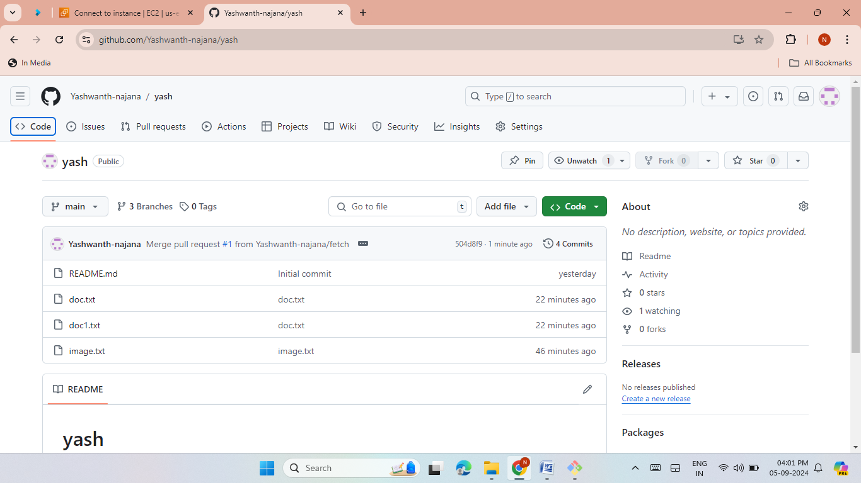
Lab 8 -Merging Branches
Created a pull request to merge branches.
Merged the feature branch into the main branch.
Click on create pull request then just click again on create pull request.
Click on confirm merge.
Verified changes in the main branch.

Slide 14
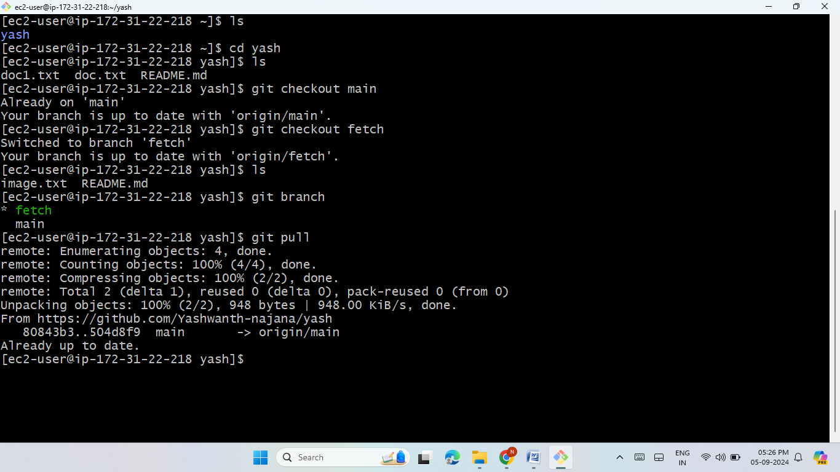
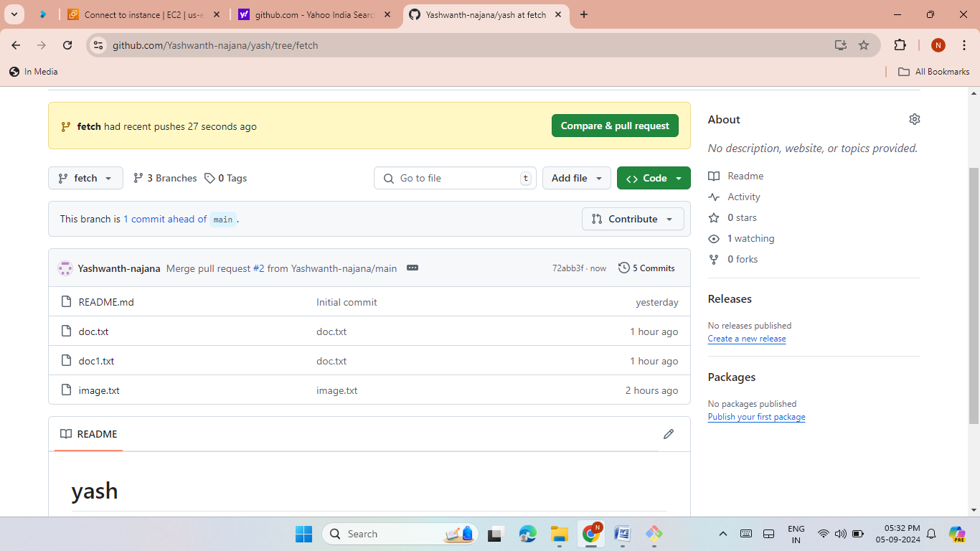
Lab 9 -Updating Local Repo
Pulled changes to the local machine.
Checkout to the fetch branch
git checkout < branch name>
Now “git pull” to pull all the new changes such as branches form the remote location.
Verified the updated content in the fetched branch.

Slide 15



Thank you!

